Slide 1

Got You Covered
Development Data Set
5/17/2019
Notes:
This presentation covers the LTE Coverage Tool Extension proposal.

Slide 2
Data Set Description
Elements to Be Provided to Contestants
“Simulated Building” map/picture of building layout
CSV file with time, coverage and location data
Purpose for CSV File Data Set
Template for data tables generated by app.
App must generate files to be processed in final evaluations for compliance and location accuracy.
Input for development of UI (same format that would be scored for accuracy in final stage; allows development of UI in parallel with location capabilities)

Slide 3
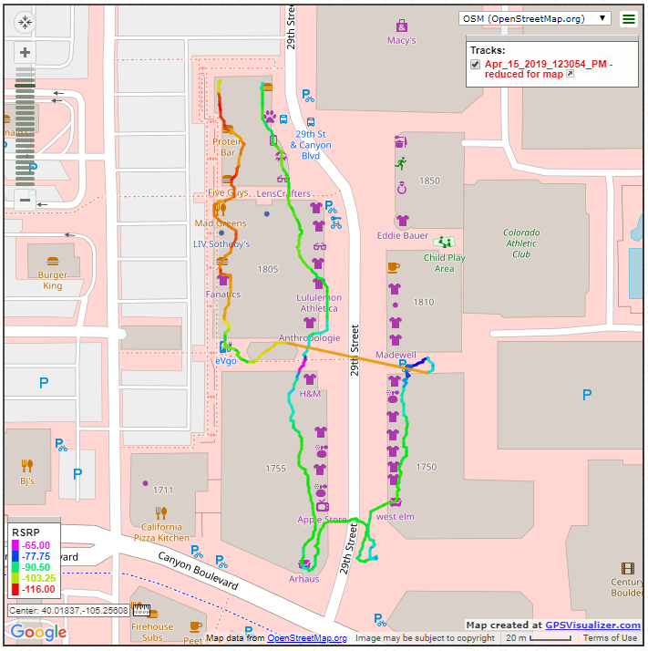
Data Set Map
© OpenStreetMap contributors

Slide 4
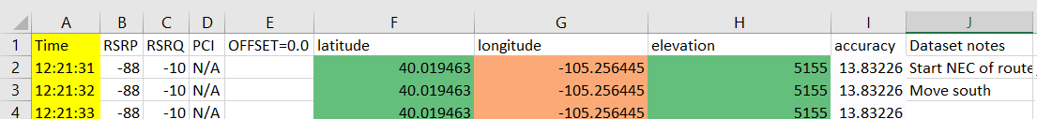
Sample CSV File (“TTP Dataset.xlsx”)
LTE Coverage Tool
Added by TTP Application
A: Time (format: 8/28/2018 12:43:54 PM)
B: RSRP (integer, range -44 to -140)
C: RSRQ (integer, range -3 to -20)
D: PCI (integer, range 0 to 503)
E: Offset (not used)
F: GPS Latitude (decimal degrees)
G: GPS Longitude (decimal degrees)
H: Altitude (m above sea level)
I…: Optional fields at participant discretion

Slide 5
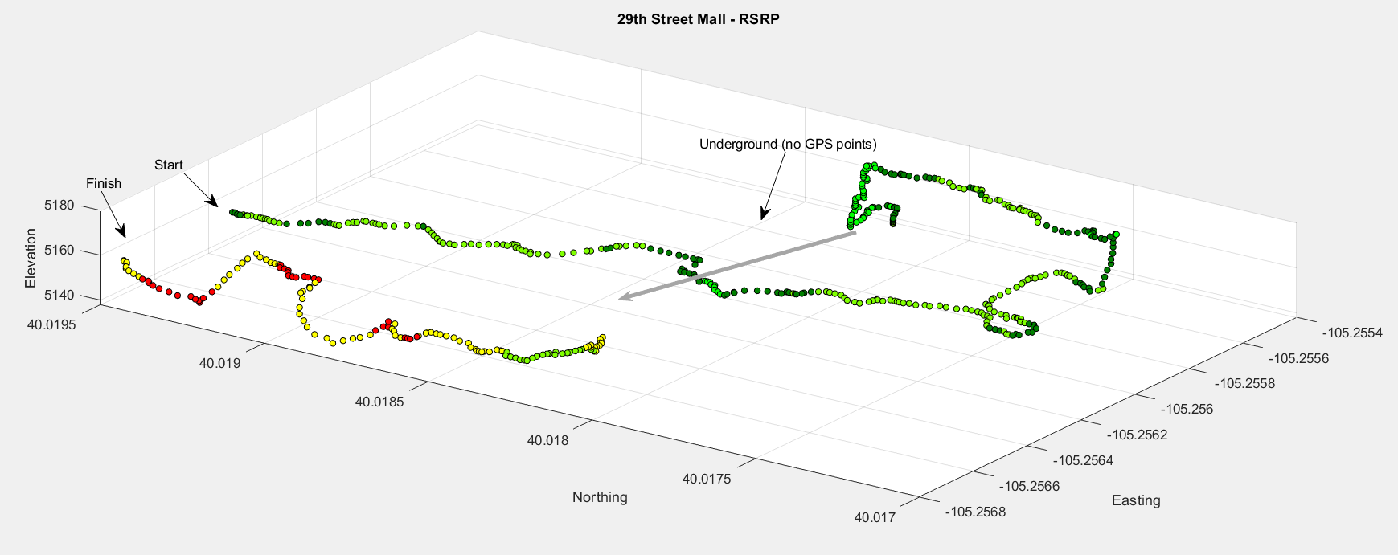
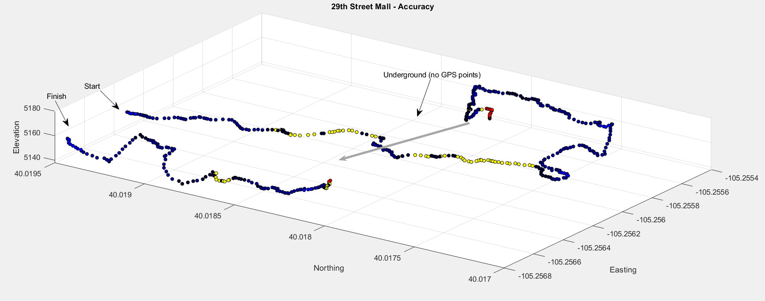
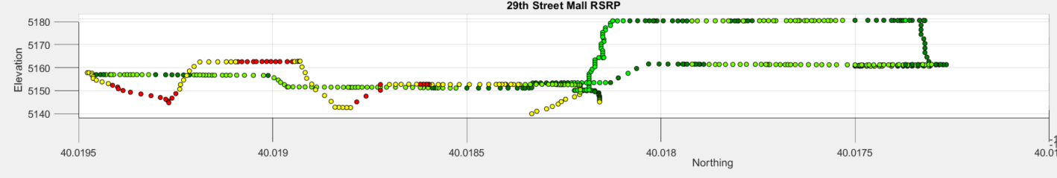
Dataset 3D Map

